Slide 1
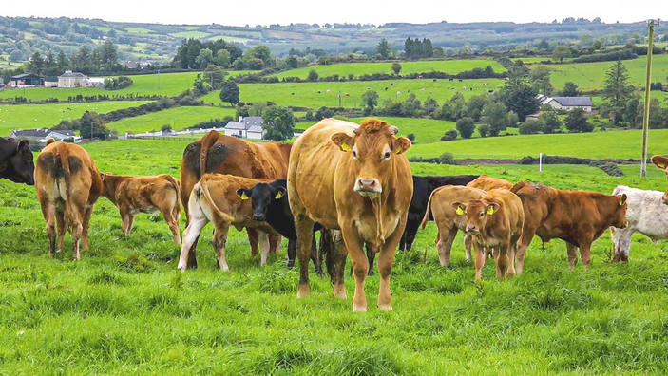




Cattle Aid- Application of Ontology – Based Veterinary Information Extraction for Cattle Skin Disease Diagnosis.
TMP-2023-24-001

Slide 2


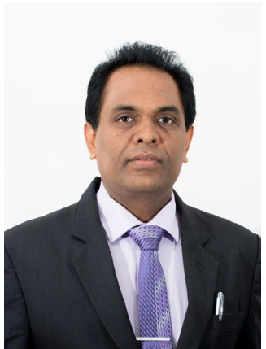
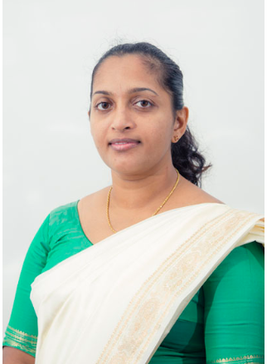
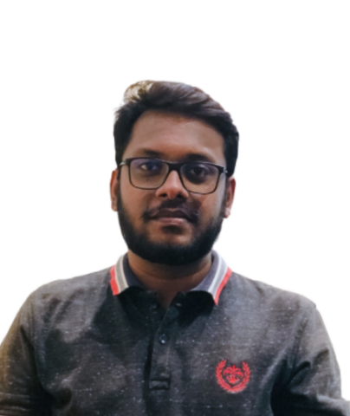
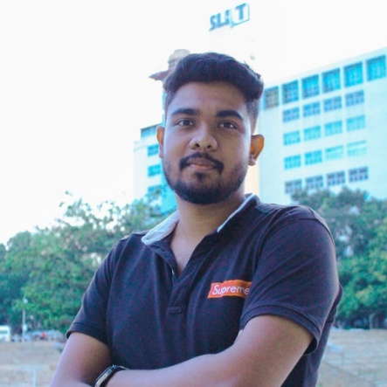
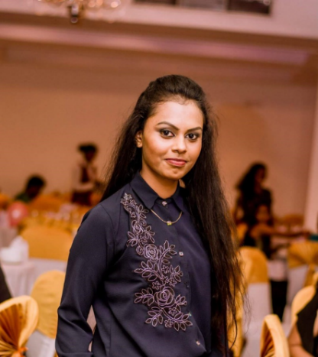
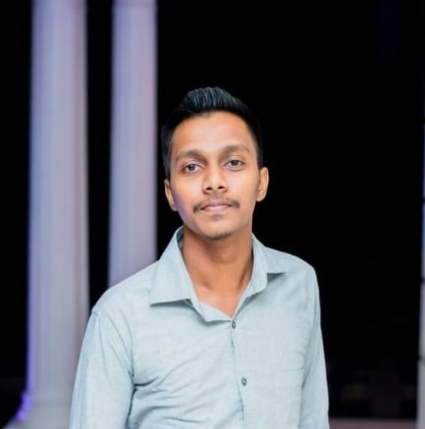

Meet Our Team!
Co-Supervisor :
Dr. Anuradha Jayakody
Supervisor :
Mrs. Suranjini Silva
Nawarathna N.N
IT20654658
Jayawardhana K.A.D.D.S
IT20651824
M.G.K.Chethani
IT20659226
Rubasinghe L.M
IT20299552

Slide 3
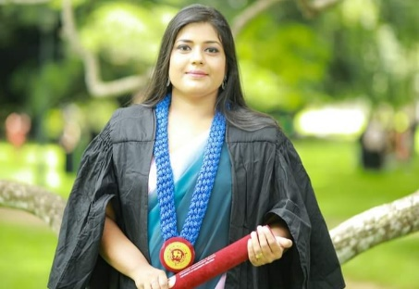
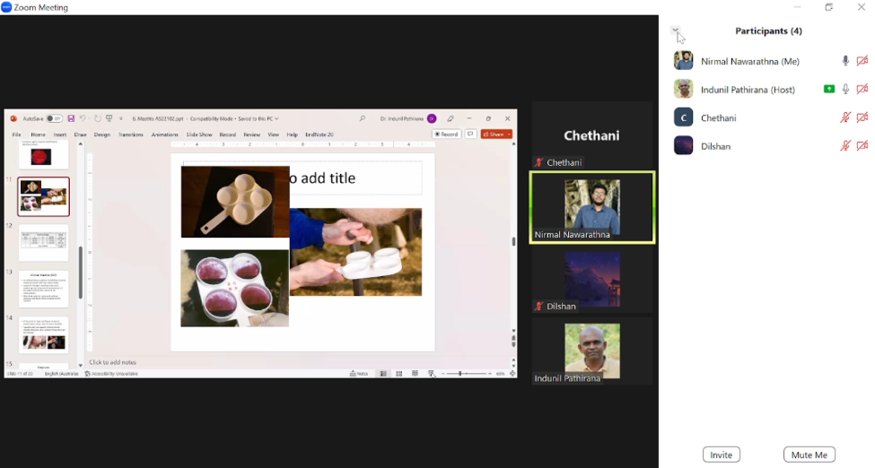
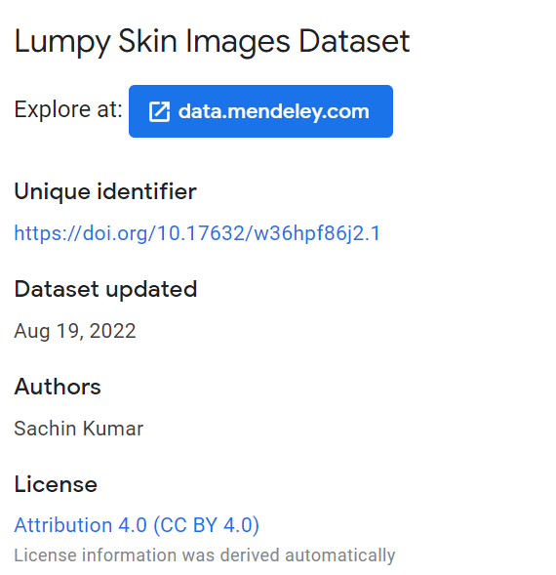
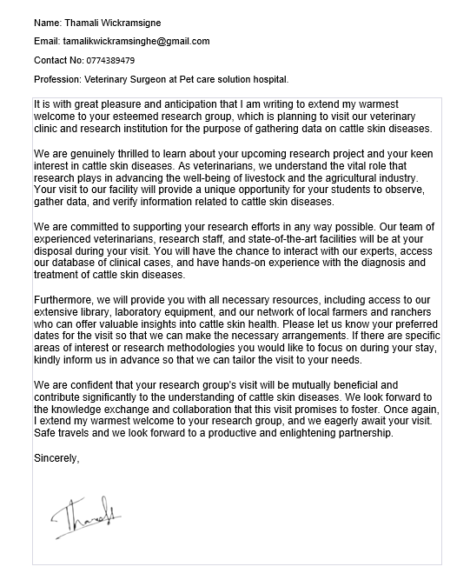
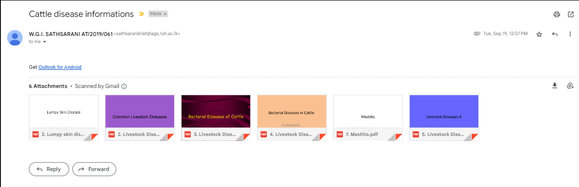
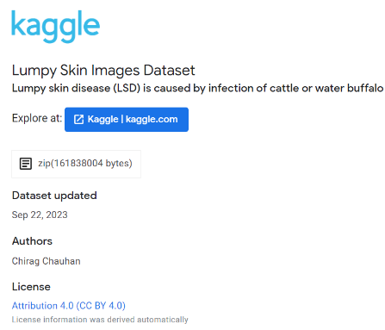

Data Gathering

Slide 4



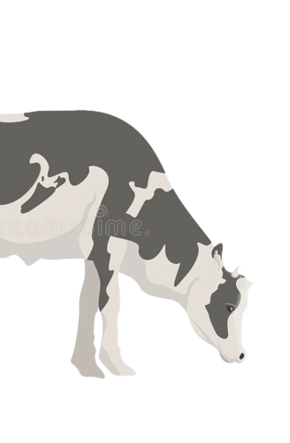
INTRODUCTION
In the dynamic landscape of veterinary medicine, technological innovations have emerged as crucial tools for addressing the challenges faced by livestock industries. In this context, our research endeavours to revolutionize the diagnosis and management of cattle skin diseases through the integration of advanced technologies and domain-specific knowledge. Our research topic, "Application of Ontology-Based Veterinary Information Extraction for Cattle Skin Disease Diagnosis," encapsulates a multidimensional approach that harnesses the power of artificial intelligence (AI) and ontology-based information extraction to enhance the understanding and handling of cattle skin diseases.

Slide 5
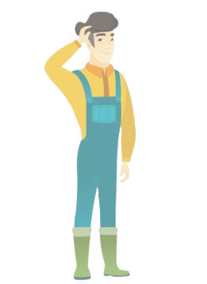

RESEARCH QUESTION
The cattle industry in Sri Lanka, a vital component of the agricultural sector, is pivotal to the nation's economy. However, the occurrence of skin diseases among cattle remains a pressing concern, impacting animal welfare, productivity, and economic stability. The conventional methods of diagnosing these diseases often rely on subjective visual assessments, leading to inconsistencies and delays in treatment. Moreover, the accurate assessment of disease severity and the efficient extraction of relevant information from diverse data sources pose formidable challenges.

Slide 6
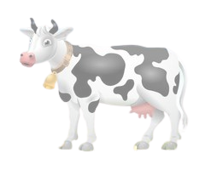
OBJECTIVES
Sub Objectives
Main Objective
Enhanced Cattle Skin Disease Detection and Severity Assessment Using Image Processing and Advanced Models
Ontology-Based Veterinary Information Extraction for Cattle Skin Disease Diagnosis
Ontology-Based Information Extraction from Data Resources
User-specific knowledge based up to date treatment details using reinforcement learning.
AI-Driven Smart Assistant for Cattle Skin Diseases

Slide 7
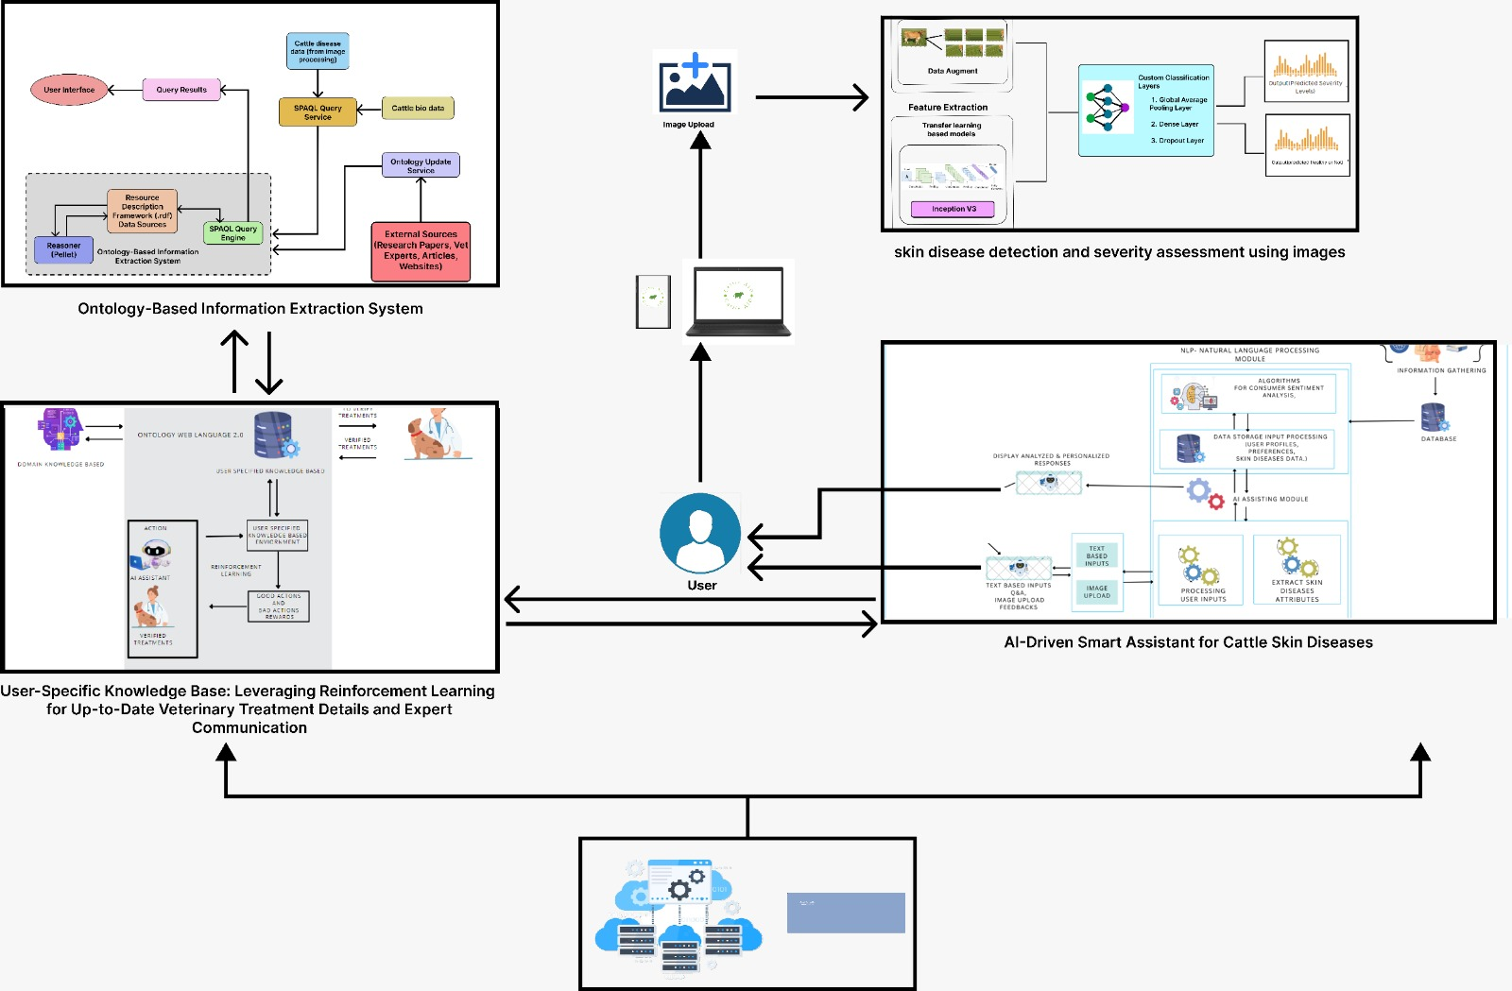
SYSTEM DIAGRAM

Slide 8

IT20654658|Nawarathna N.N
Bachelor of Science (Hons) in Information Technology
Specializing in Software Engineering
Enhanced Cattle Skin Disease Detection and Severity Assessment Using Image Processing and Advanced Models
IT20654658 | Nawarathna N.N | TMP-2023-24-001

Slide 9


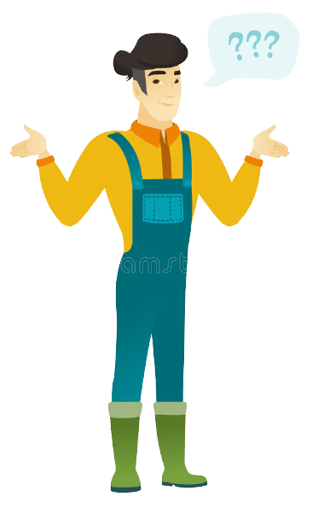
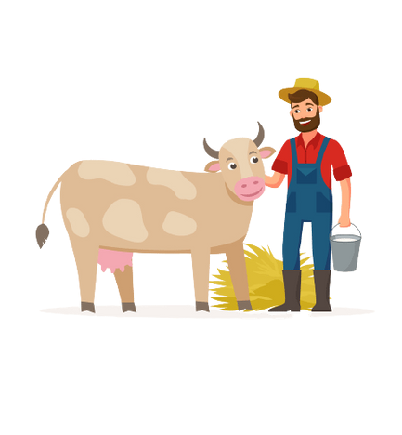
RESEARCH QUESTION
What image processing techniques work best for early and accurate detection of "Lumpy Skin" cattle?
How can advanced machine learning and deep learning models be used to evaluate the severity of cattle skin diseases, and what are the appropriate performance metrics to gauge their accuracy?
IT20654658 | Nawarathna N.N | TMP-2023-24-001

Slide 10



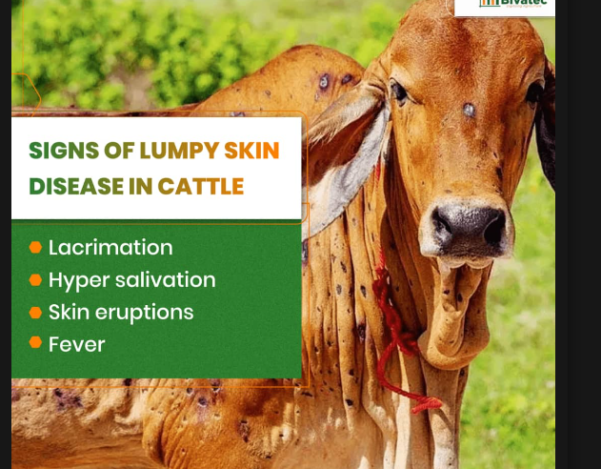
BACKGROUND
Objective: To improve the identification and severity assessment of cattle skin diseases using
image processing and advanced models.
Key Tasks:
Identify Cattle Skin Diseases: Implement advanced image processing techniques to accurately identify common cattle skin diseases.
Severity Assessment: Develop a severity assessment model for early detection and monitoring of disease progression.
Targeted Diseases:
Focus on "Lumpy Skin“ the most prevalent cattle skin diseases.
IT20654658 | Nawarathna N.N | TMP-2023-24-001
Notes:
Lumpy skin disease is a viral disease that affects cattle. It is transmitted by blood-feeding insects, such as certain species. of flies and mosquitoes, or ticks. It causes fever, nodules on the skin and can also lead to death, especially in animals that that have not previously been exposed to the virus.
Papillomas are benign, sometimes multiple, tumors caused by viruses. They are commonly known as warts.

Slide 11



COMPLETION SUMMARY OF SUB OBJECTIVE
SUB OBJECTIVE
Binary Classification Model
Advanced Models Implementation
Severity Assessment
IT20654658 | Nawarathna N.N | TMP-2023-24-001

Slide 12
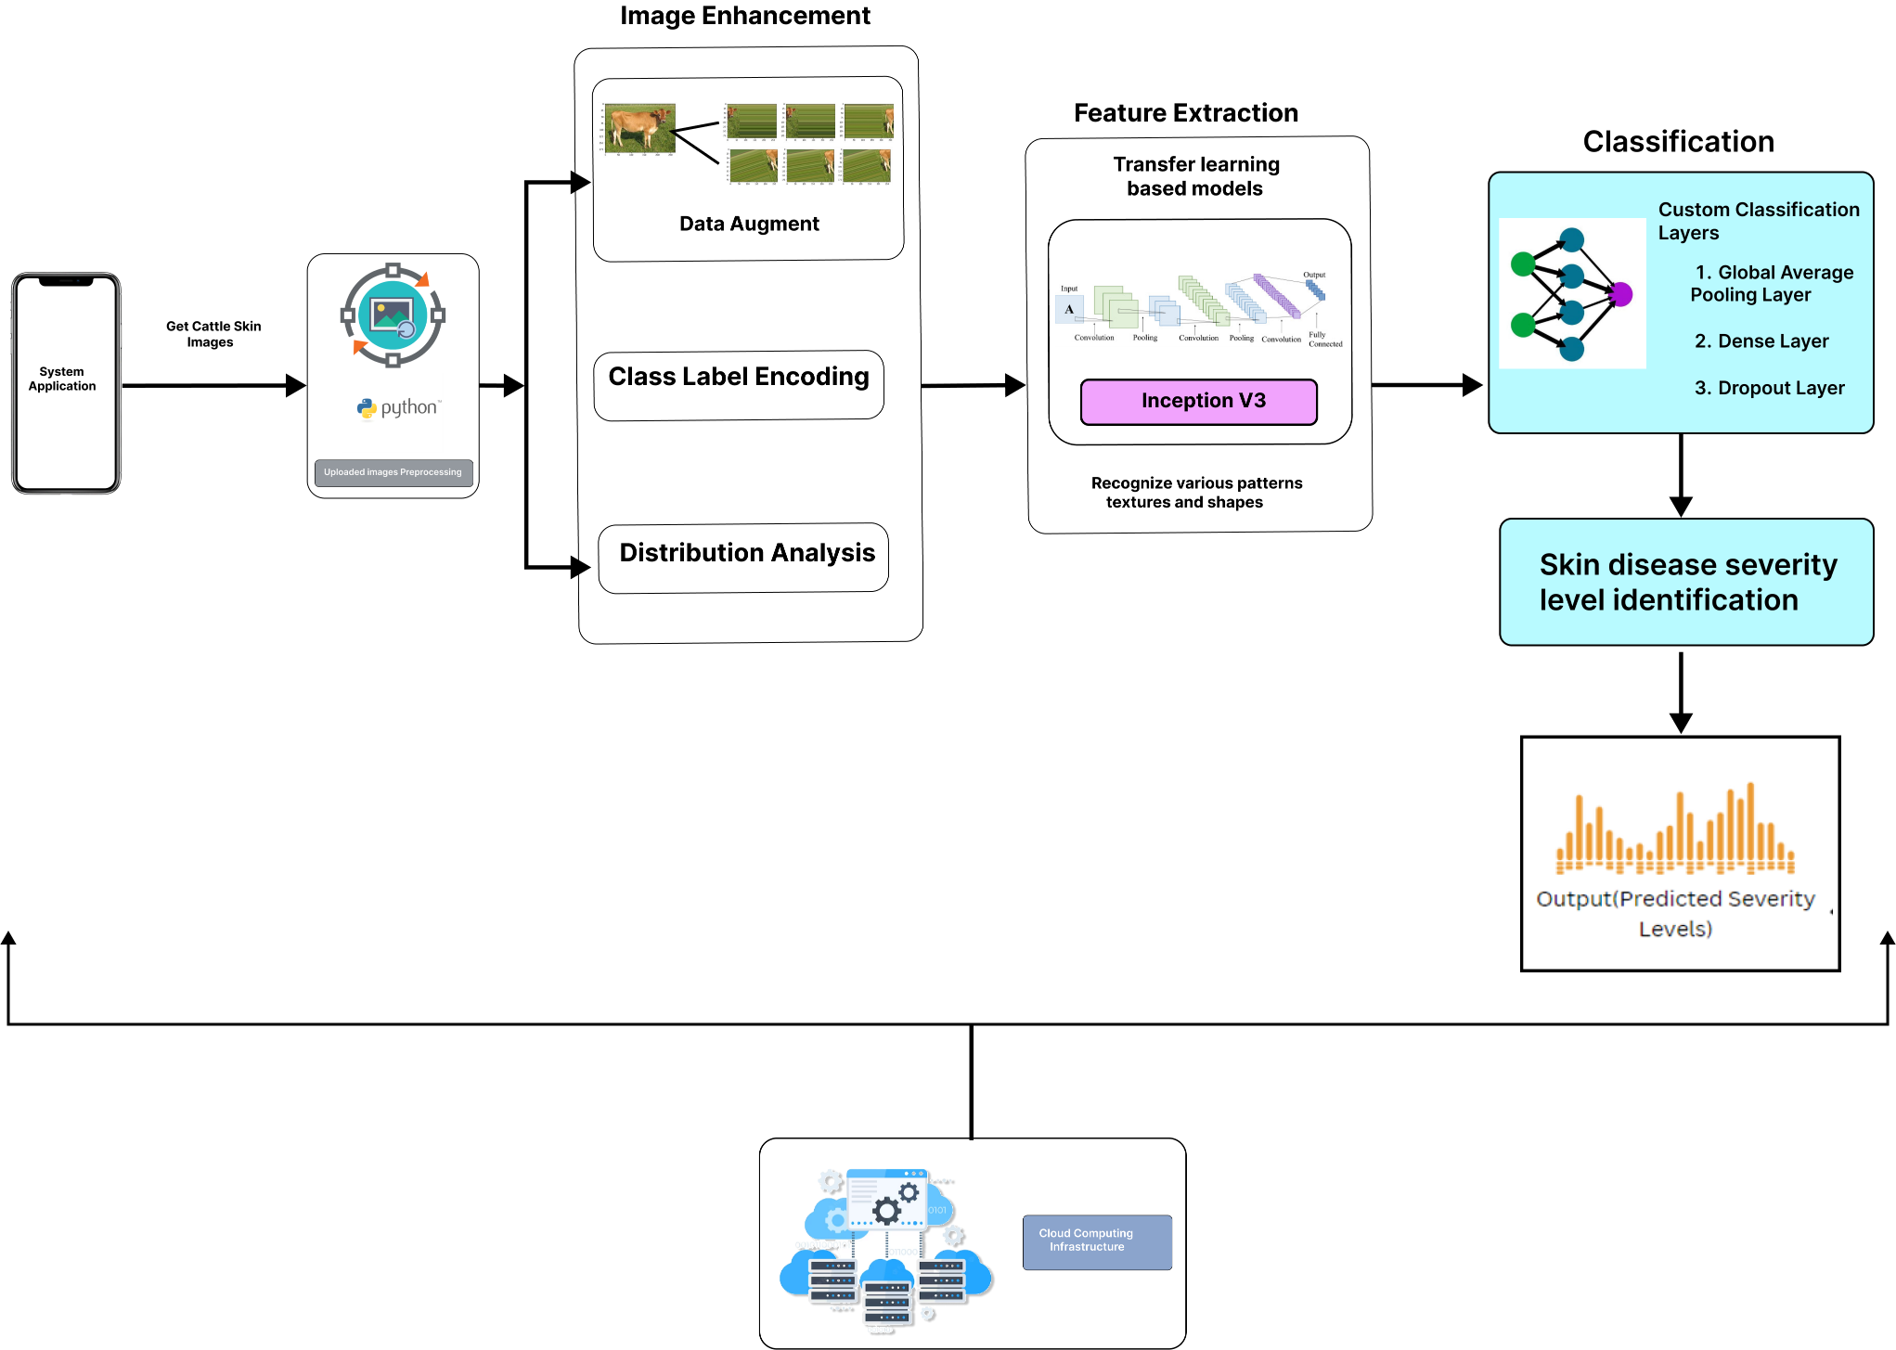

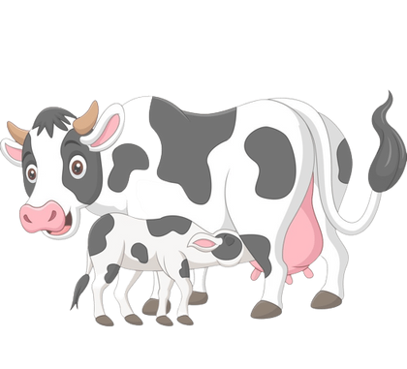
SYSTEM DIAGRAM
IT20654658 | Nawarathna N.N | TMP-2023-24-001
Notes:
First, small-scale farmers can use our mobile application to register cattle by entering basic details of the animals. After that, users can capture an image with their mobile devices and upload it to our application. Once the image is uploaded, the cattle skin disease identification process involves three main steps: image enhancement, feature extraction, and classification. Finally, after these three main processes, the severity level of the skin disease is identified.

Slide 13
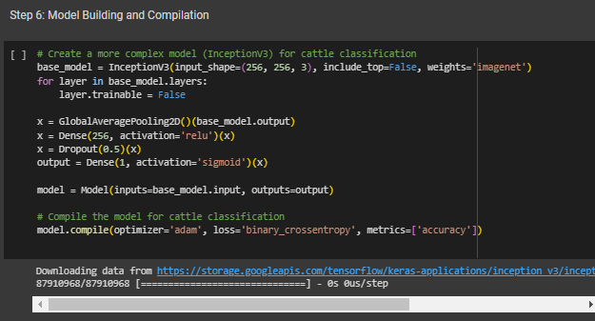

Select the best algorithm for the model with highest accuracy
Model | Testing Accuracy | Key Features
First Model | 69.15% | Basic CNN architecture , Minimal data
Second Model | 71.43% | Data augmentation, Improved accuracy
Last Model | 86.94% | Transfer learning (Inception V3) , Data Augmentation , significantly improved accuracy , and fast training
use of transfer learning with Inception V3, data augmentation, and dropout layers, which collectively led to a remarkable accuracy of 86.94%.
IT20654658 | Nawarathna N.N | TMP-2023-24-001
Notes:
The base model I use inceptionv3 its pretrained neural network this network can understand many features in images from large dataset.
After getting the feature of images using this global average pooling taking the average of the features this makes the information more compact and easier to work with
After that dense layer collect the all combined feature and try to understand them even better. dense layer use 256 neurons to understand the features and patterns
After that using dropout prevent overfitting some time in taring some neurons randomly take breaks that’s why use this dropout layer
And get using dense layer and make decision based on gathered information.
In compliation part use adam optimizer its helps the model learn better from its mistakes and use loss function its measure how accurate its predictions are compared to the acutual label

Slide 14
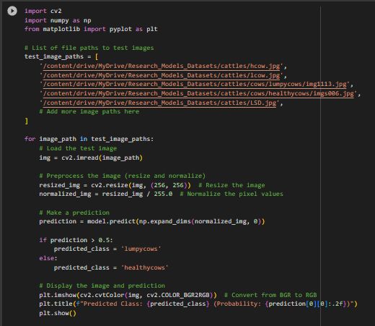
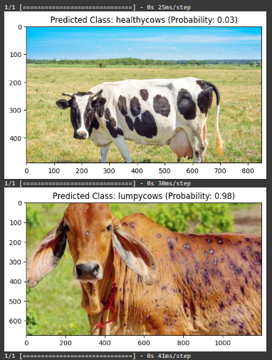
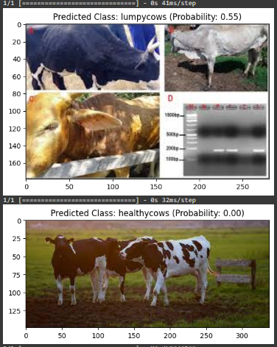
Methodology
Evidence of Completion
Identify skin diseases
IT20654658 | Nawarathna N.N | TMP-2023-24-001

Slide 15
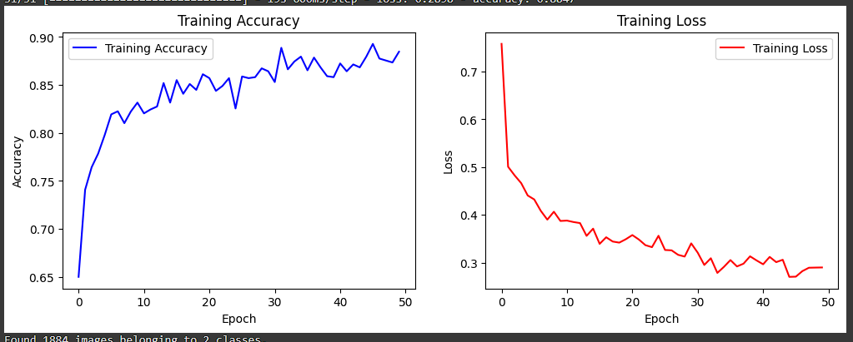
Methodology
Evidence of Completion
Identify skin diseases
IT20654658 | Nawarathna N.N | TMP-2023-24-001

Slide 16
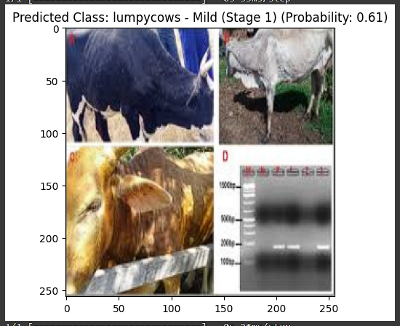
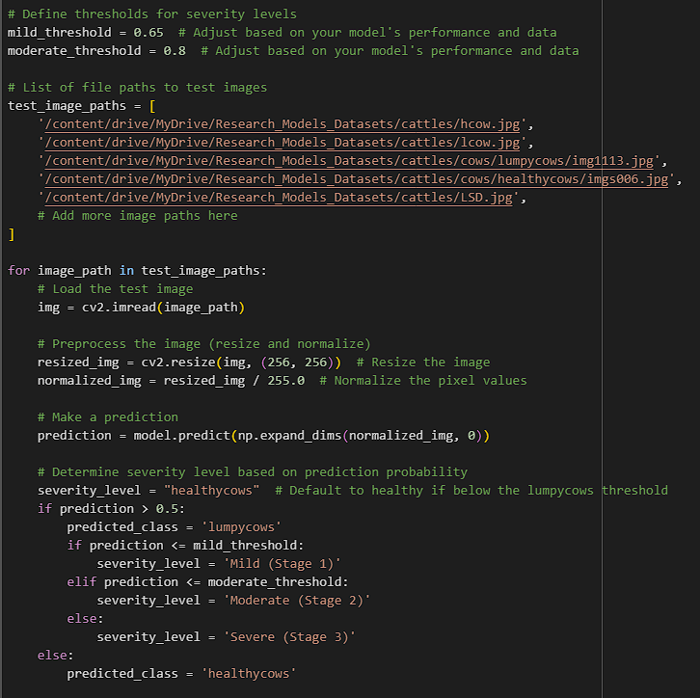
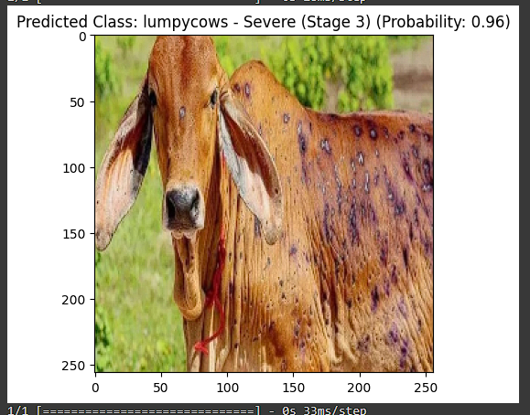
Methodology
Evidence of Completion
Severity Assessment
Severity Stage 1 :- Mild
Severity Stage 3 :- Severe
IT20654658 | Nawarathna N.N | TMP-2023-24-001

Slide 17

IT20651824|K.A.D.D.S Jayawardhana
Bachelor of Science (Hons) in Information Technology
Specializing in Software Engineering
Ontology-based Information Extraction System for Sri Lankan Cattle Domain and Educating Small-scale Farmers
IT20651824 | K.A.D.D.S Jayawardhana | TMP-2023-24-001

Slide 18
The research gap?
Our System Solution?
Final Output (Application Demonstration)?
Backend Ontology Development?
IT20651824 | K.A.D.D.S Jayawardhana | TMP-2023-24-001

Slide 19
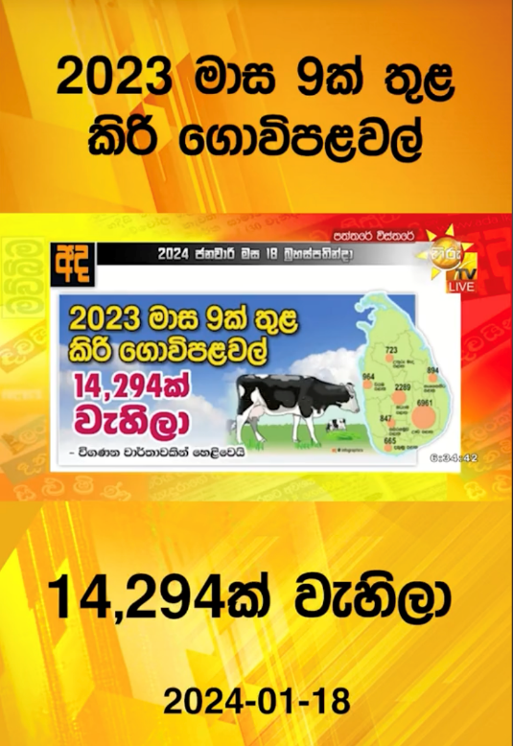

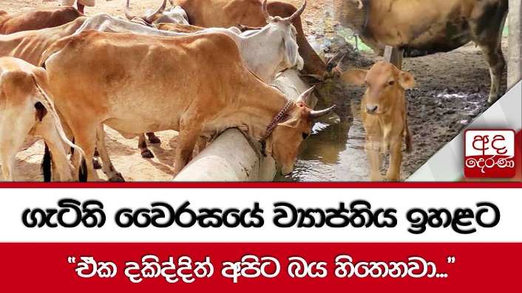
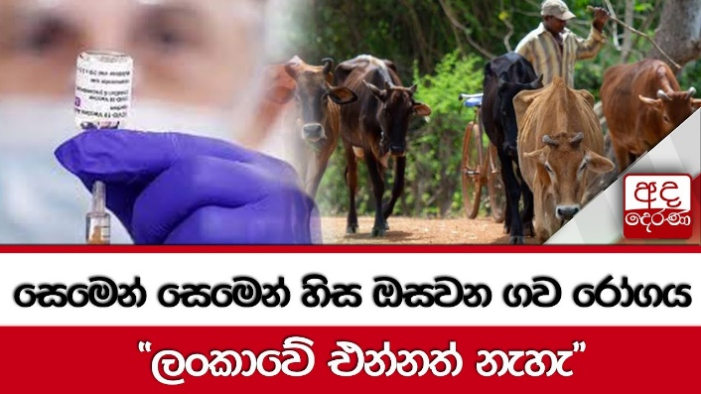
RESEARCH QUESTION
"How does the lack of knowledge regarding cattle health and well-being among small-scale farmers in Sri Lanka affect the prevalence of diseases and infections in their cattle, and what are the most effective strategies for improving awareness and management of cattle health within this community?"
IT20651824 | K.A.D.D.S Jayawardhana | TMP-2023-24-001

Slide 20
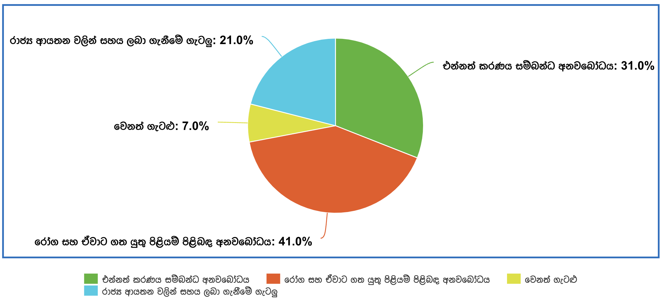
SURVEY INFORMATION
Participated in 27 small-scale cattle farmers in western, southern and north-central provinces.
IT20651824 | K.A.D.D.S Jayawardhana | TMP-2023-24-001

Slide 21
COMPLETION SUMMARY OF SUB OBJECTIVE
SUB OBJECTIVE
Binary Classification Model
Advanced Models Implementation
Severity Assessment

Slide 22
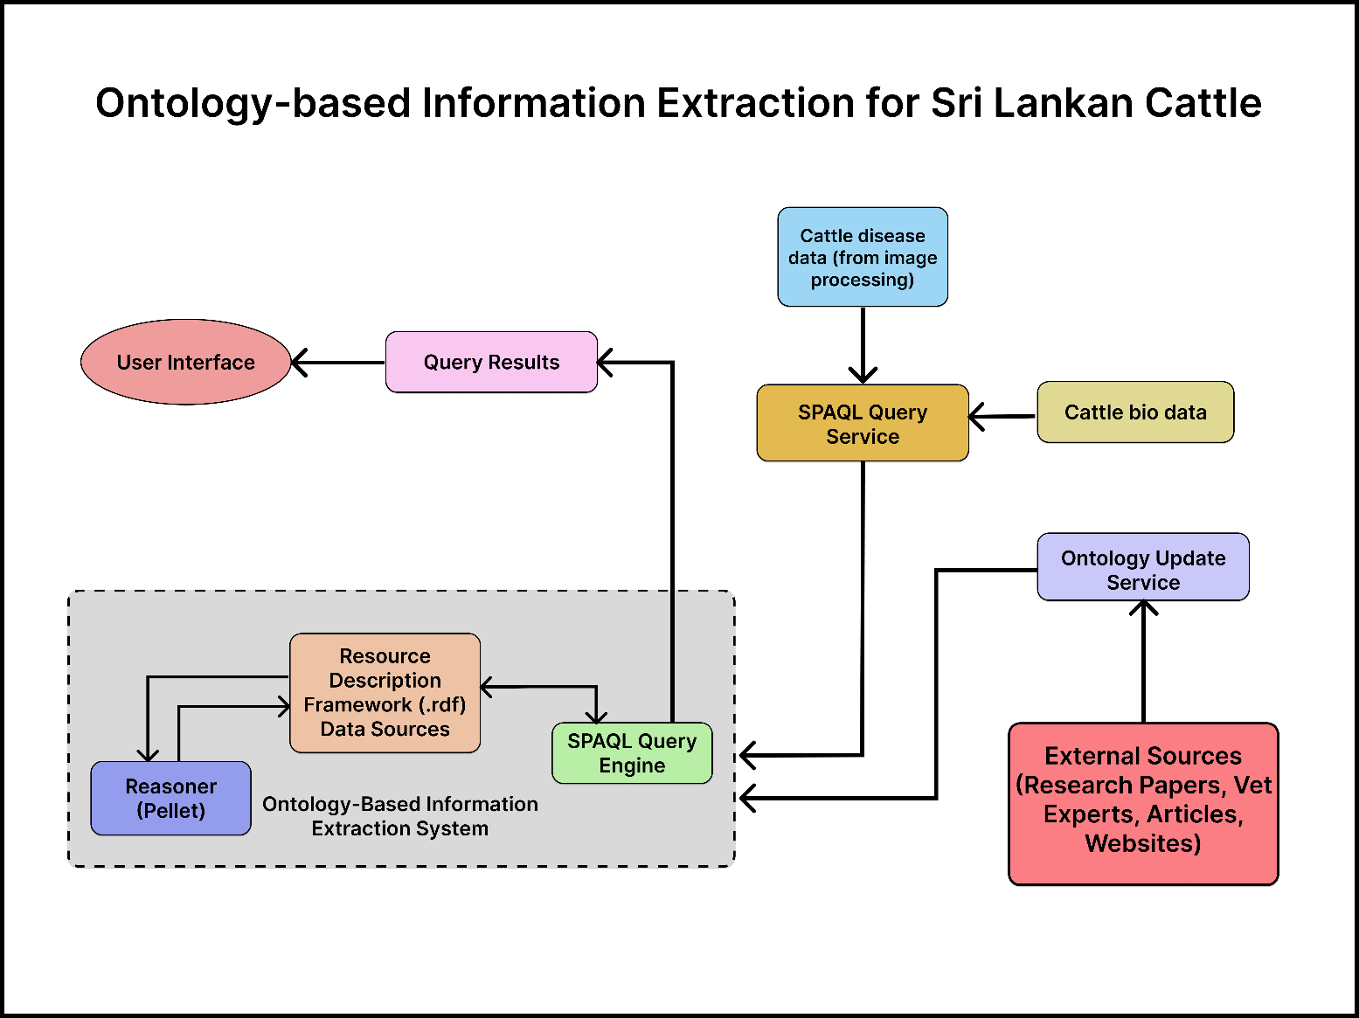
SYSTEM DIAGRAM
IT20651824 | K.A.D.D.S Jayawardhana | TMP-2023-24-001

Slide 23
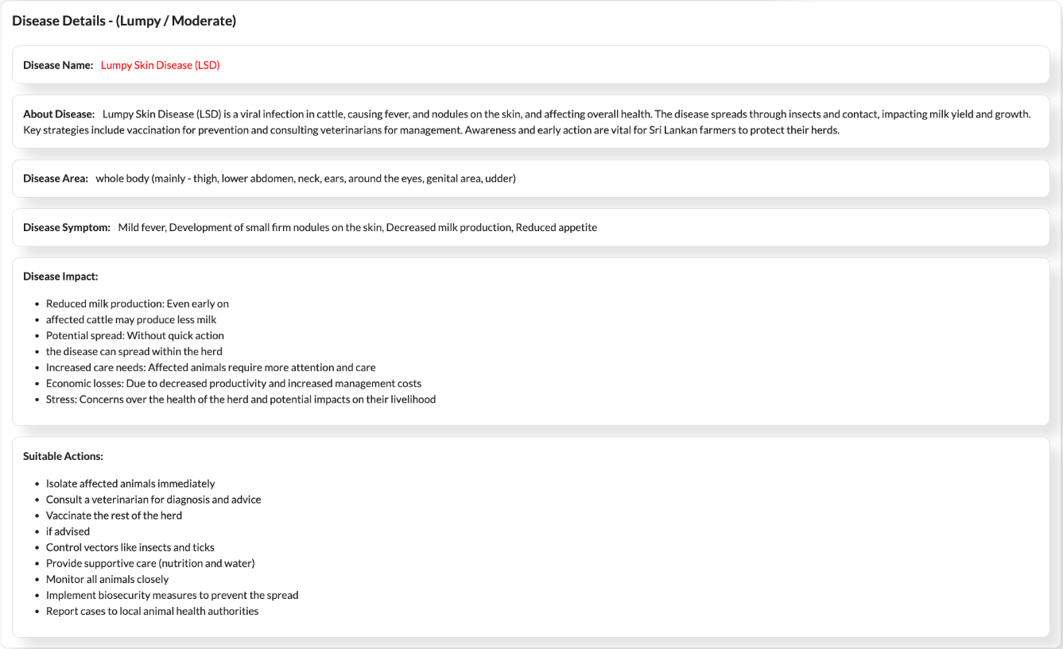
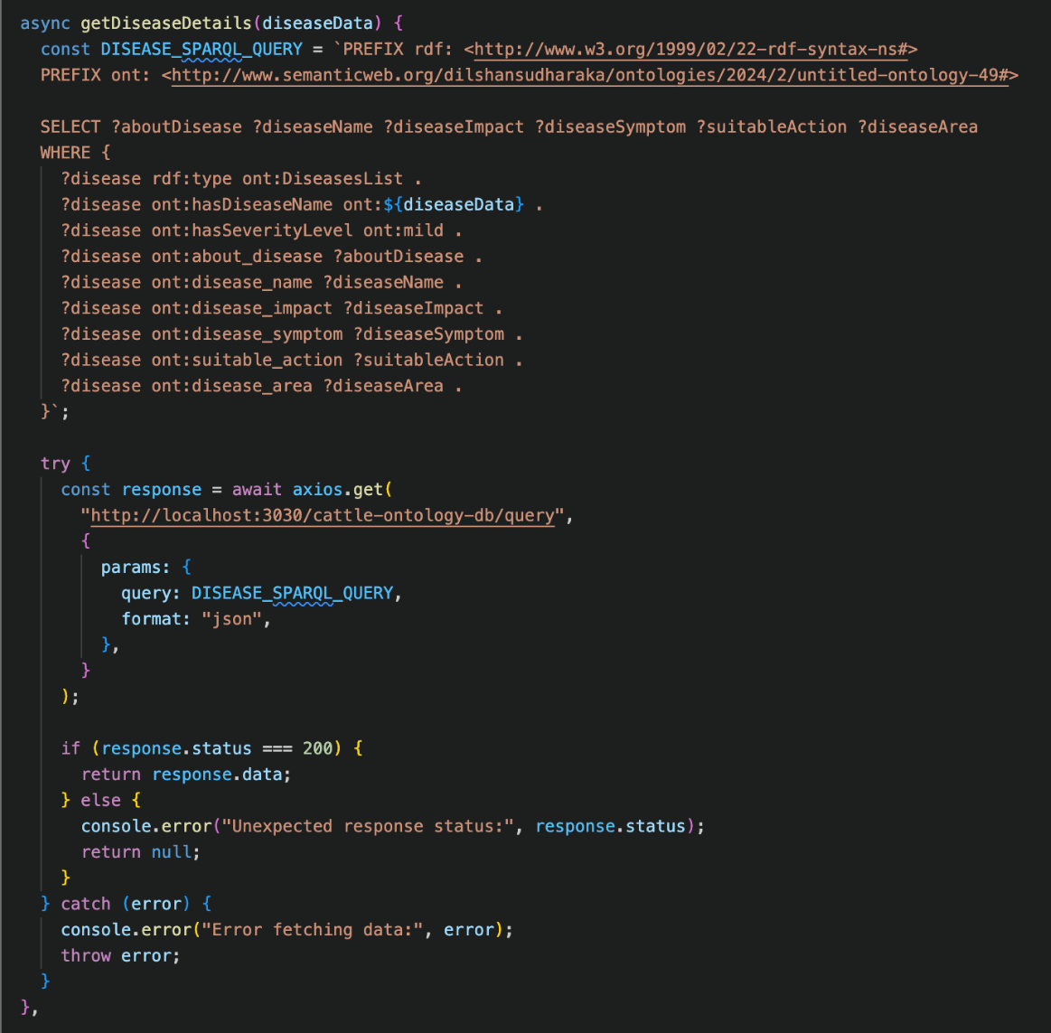
Get Cattle Disease Details using SPARQL Query
IT20651824 | K.A.D.D.S Jayawardhana | TMP-2023-24-001

Slide 24
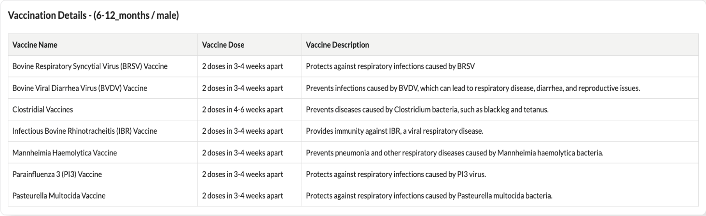
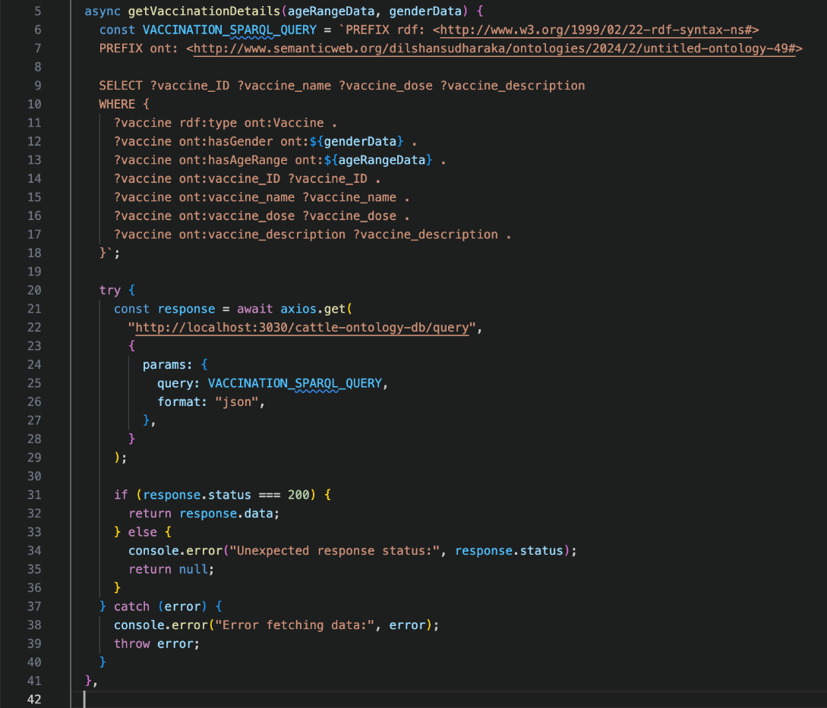
Get Cattle Vaccination Details using SPARQL Query
IT20651824 | K.A.D.D.S Jayawardhana | TMP-2023-24-001

Slide 25
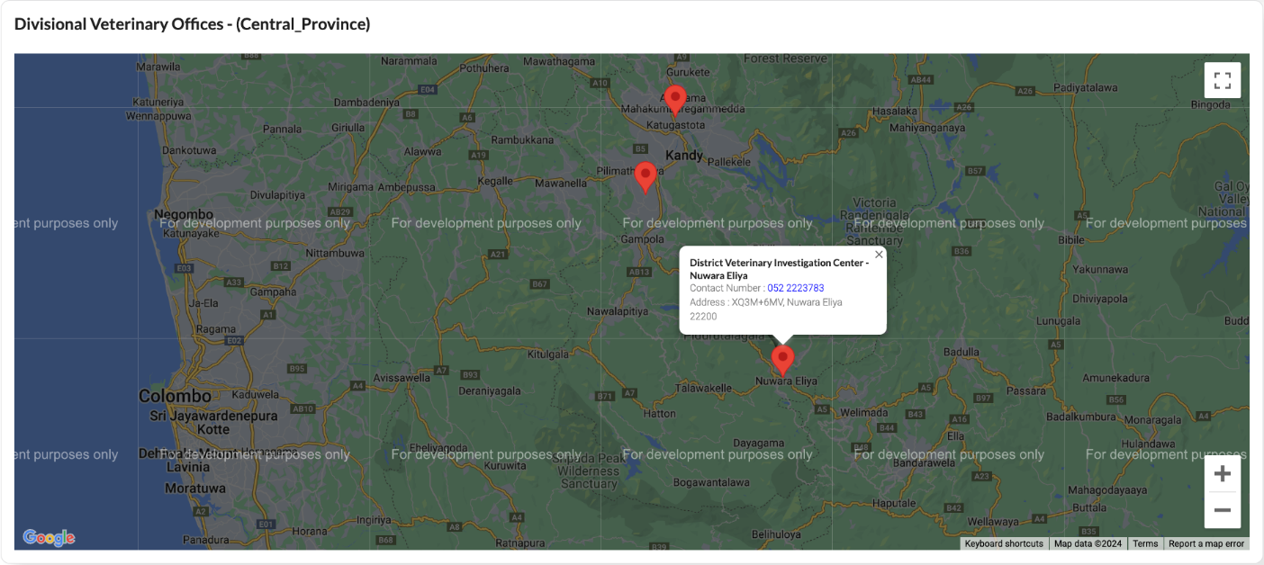
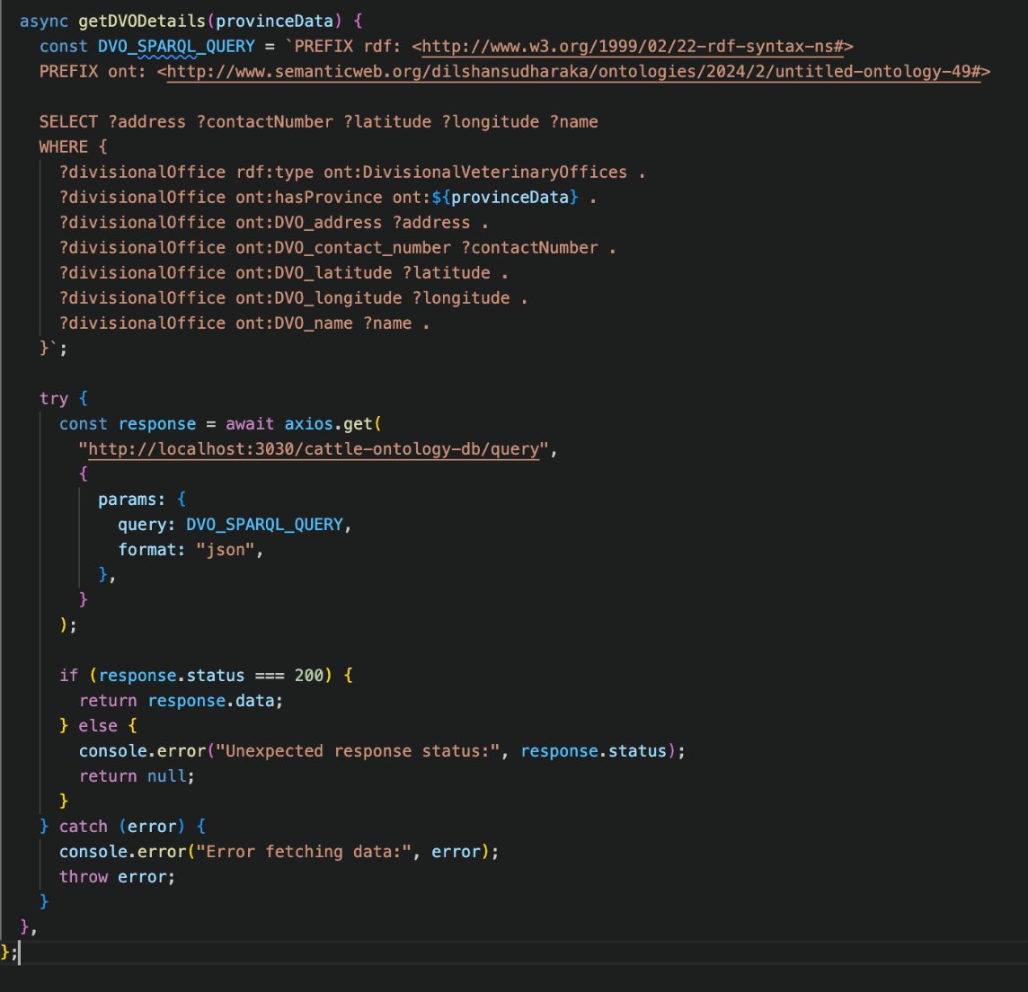
Get District Veterinary Investigation Centres Details using SPARQL Query
IT20651824 | K.A.D.D.S Jayawardhana | TMP-2023-24-001

Slide 26
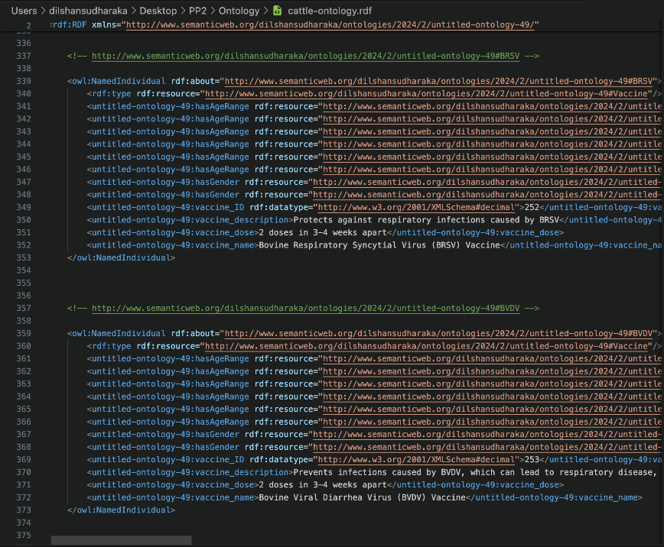
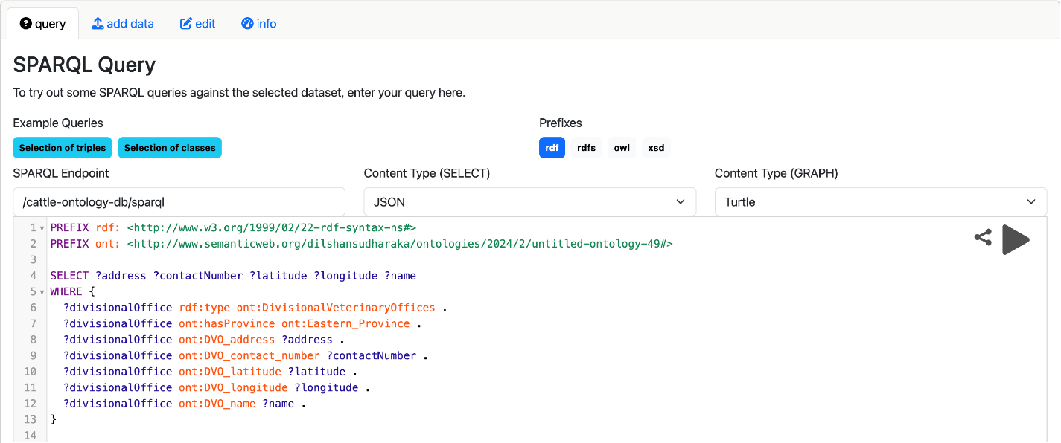
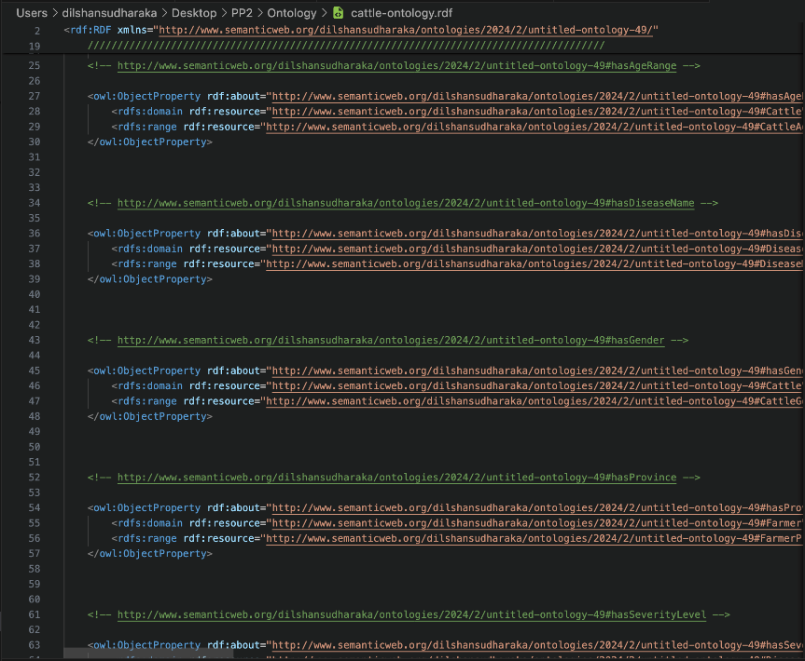
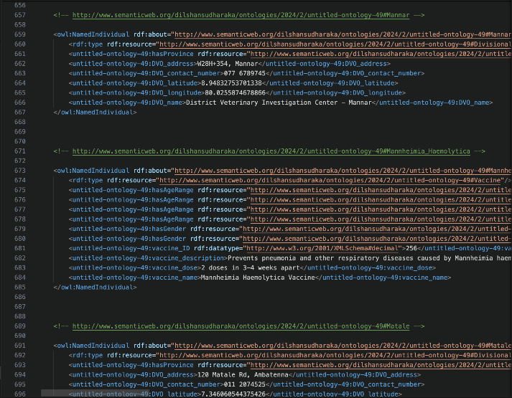
Save as (.rdf) formate and Run on Apache Jena Fuseki Server
IT20651824 | K.A.D.D.S Jayawardhana | TMP-2023-24-001

Slide 27
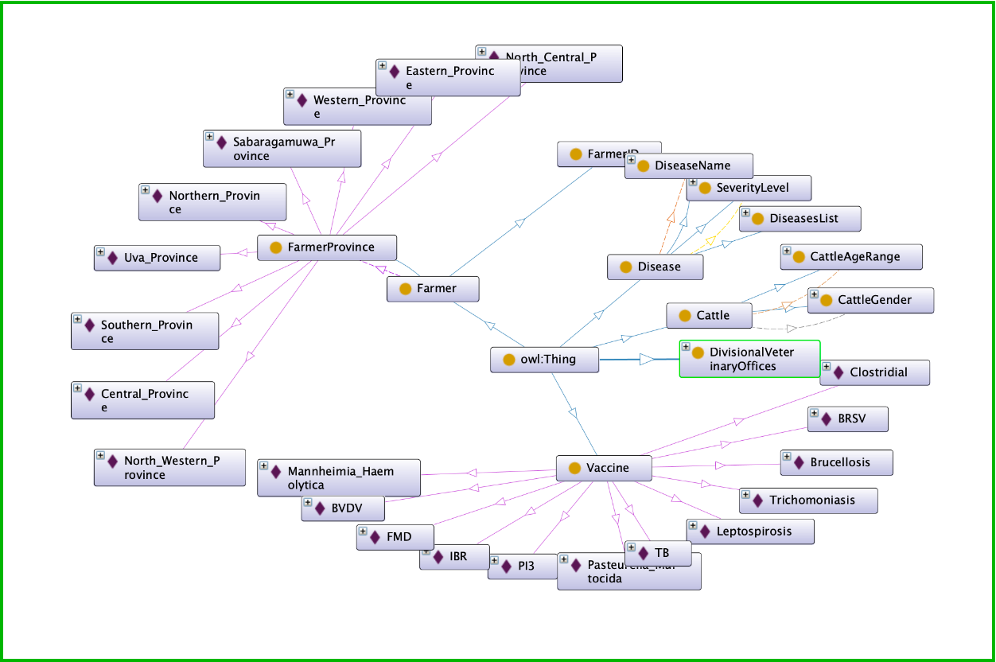
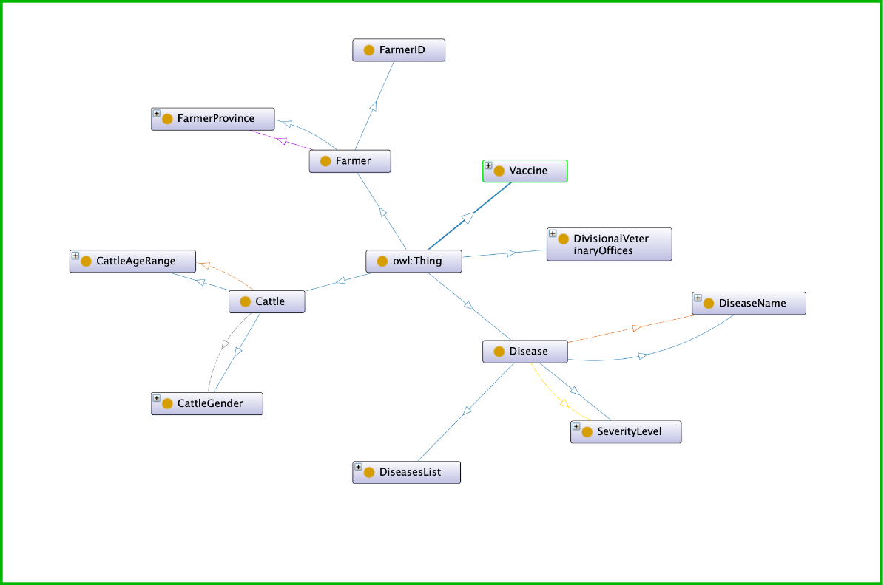
Classes and Sub-classes with their instances Graph View in Protégé
Classes and Sub-classes Graph View in Protégé
IT20651824 | K.A.D.D.S Jayawardhana | TMP-2023-24-001

Slide 28
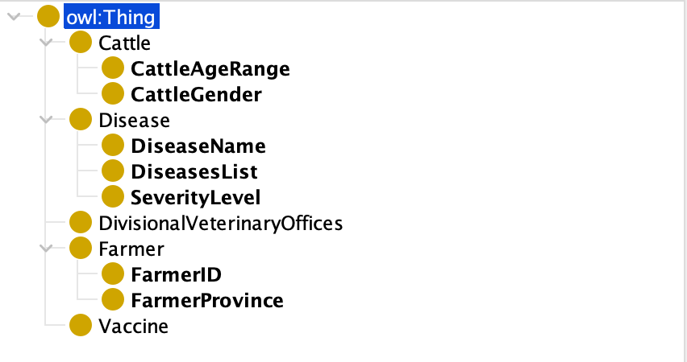
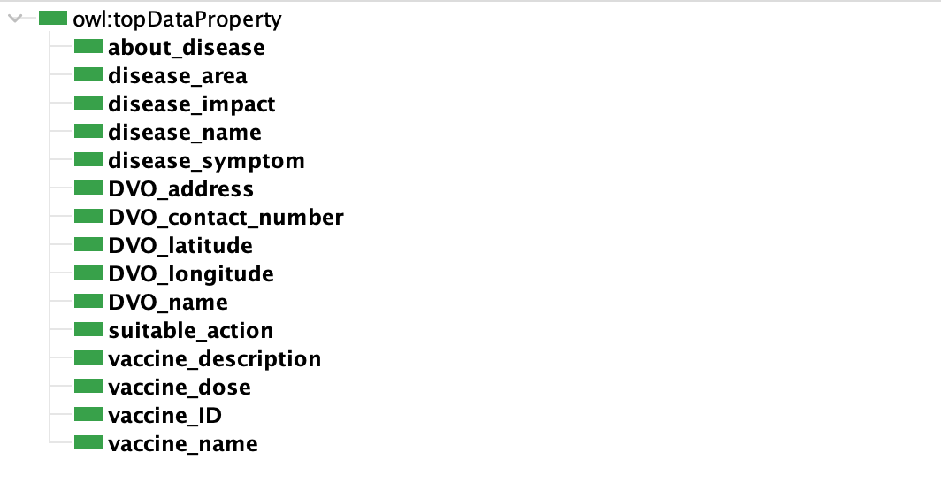
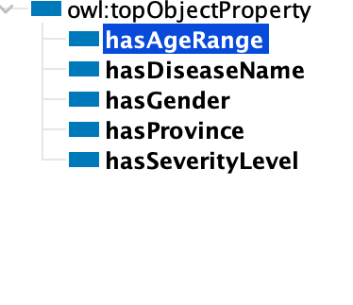


Classes
Object Property
Data Property
IT20651824 | K.A.D.D.S Jayawardhana | TMP-2023-24-001

Slide 29

IT20659226|M.G.K.Chethani
Bachelor of Science (Hons) in Information Technology
Specializing in Information Technology
Veterinary contacting and user-specific knowledge based up-to-date using reinforcement learning.
IT20659226 | M.G.K.Chethani | TMP-2023-24-001

Slide 30

INTRODUCTION - BACKGROUND
In this component I am to create a user-specific knowledge base by filtering the treatment details from the domain knowledge-based, we contact a vet through a mobile application to clarify that suggested treatment details can be used for those treatments, verify treatment details and suggestions needs up to date in the user-specific knowledge-based when users ask questions from AI assistants that user-specific knowledge should be up to date.
IT20659226 | M.G.K.Chethani | TMP-2023-24-001

Slide 31

SYSTEM DIAGRAM
IT20659226 | M.G.K.Chethani | TMP-2023-24-001

Slide 32
RESEARCH QUESTION
How can advanced technologies, be effectively applied to improve the diagnosis and management of cattle skin diseases in the livestock industry?
IT20659226 | M.G.K.Chethani | TMP-2023-24-001

Slide 33

COMPLETION SUMMARY OF SUB OBJECTIVE
Implemented a system to contact vet
Update the treatment details using an algorithm in reinforcement
Notify the farmer about the treatment details
IT20659226 | M.G.K.Chethani | TMP-2023-24-001

Slide 34


Developing the application for contact vet By Farmer account
IT20659226 | M.G.K.Chethani | TMP-2023-24-001

Slide 35



Developing the application for Response by vet
IT20659226 | M.G.K.Chethani | TMP-2023-24-001

Slide 36



Backend Algorithms using reinforcement techniques
IT20659226 | M.G.K.Chethani | TMP-2023-24-001

Slide 37






Tools and Technologies
Technologies
React
Express Js
MongoDB
Python
OWL (Web Ontology Language) - standard ontology language
Reinforcement learning algorithms
Techniques
IT20659226 | M.G.K.Chethani | TMP-2023-24-001

Slide 38
Functional, Non-Functional Requirements
Functional Requirements
Non - Functional Requirements
Technologies
Techniques
Data collecting and analyzing
Knowledge Update and Adaptation
Knowledge Based decision making
User-friendly interfaces
Availability
Scalability
Security
IT20659226 | M.G.K.Chethani | TMP-2023-24-001

Slide 39
References
[1] Ghayvat, H., Al-Sharabi, M., & Mukhopadhyay, S. C. (2017). Ontology-based knowledge representation for smart agriculture. IEEE Transactions on Industrial Informatics, 13(6), 3172-3180
[2] Nauta, M. J., Borne, J. J. G. C., Berg, P., & Klei, L. (2015). Development of an ontology for cattle disease and associated phenotypes. The 6th International Conference on Biomedical Ontology (ICBO-2015), CEUR Workshop Proceedings
[3] Thomas, J., & Stiles, J. (2013). Ontology-based decision support system for diagnosis and treatment of cattle diseases. Computers in Industry, 64(6), 756-767
[4] Krithivasan, R., Venkatesan, R., & Samy, S. G. (2019). Ontology-based diagnosis and management of cattle skin diseases using machine learning. Computers in Biology and Medicine, 109, 173-182.
IT20659226 | M.G.K.Chethani | TMP-2023-24-001

Slide 40

IT20299552|Rubasinghe L.M
Bachelor of Science (Hons) in Information Technology
Specializing in Information Technology
AI-Driven Smart Assistant for Cattle Skin Diseases
IT20299552 | Rubasinghe L.M | TMP-2023-24-001

Slide 41
RESEARCH QUESTION
In the field of handling the health of cattle, an important gap exists in the capability of artificial intelligence (AI) to understand and react to the complicated emotional expressions of veterinarians and farmers. The difficulty is in creating an AI system that can dynamically change its responses depending on developing emotional context within domain-specific conversations on cattle skin diseases.
IT20299552 | Rubasinghe L.M | TMP-2023-24-001

Slide 42
INTRODUCTION - BACKGROUND
Focus on building AI-driven smart assistant using sentiment analysis, tailored to the domain of cattle skin diseases.
The smart assistant can interact with users (veterinarians, cattle farmers, etc.) to provide information about disease detection, severity assessment and potential treatments.
Sentiment analysis can be integrated to understand user emotions and responses, enhancing the interaction experience.
By processing textual interaction the assistant offers personalized advice, treatment suggestions, and educational information, fostering better collaboration and informed decision-making.
IT20299552 | Rubasinghe L.M | TMP-2023-24-001

Slide 43
Sub Objectives
COMPLETION SUMMARY OF SUB OBJECTIVE
Data Analysis of Cattle Skin Diseases
Implement an Advanced Dialog Management
Develop an Emotionally
Intelligent AI Smart Assistant
Generate personalized care plans
Address Ethical Considerations
and Data Privacy
IT20299552 | Rubasinghe L.M | TMP-2023-24-001

Slide 44

SYSTEM DIAGRAM
IT20299552 | Rubasinghe L.M | TMP-2023-24-001

Slide 45


METHODOLOGY - EVIDENCE OF COMPLETION
IT20299552 | Rubasinghe L.M | 2023-24-001

Slide 46


METHODOLOGY - EVIDENCE OF COMPLETION
IT20299552 | Rubasinghe L.M | 2023-24-001

Slide 47


METHODOLOGY - EVIDENCE OF COMPLETION
IT20299552 | Rubasinghe L.M | 2023-24-001

Slide 48


METHODOLOGY - EVIDENCE OF COMPLETION
IT20299552 | Rubasinghe L.M | 2023-24-001

Slide 49


METHODOLOGY - EVIDENCE OF COMPLETION
IT20299552 | Rubasinghe L.M | 2023-24-001

Slide 50




METHODOLOGY - EVIDENCE OF COMPLETION
IT20299552 | Rubasinghe L.M | 2023-24-001

Slide 51




METHODOLOGY - EVIDENCE OF COMPLETION
IT20299552 | Rubasinghe L.M | 2023-24-001

Slide 52


Commercialize

Slide 53

Commercialize Plan
Non-Profitable
Commercialization Strategy
1. Advertisement Play Button
Description of how advertisements will be integrated into the application
Benefits of advertisements (e.g., revenue generation)
2. Donations
How donations will be solicited from users
Planned use of donations (e.g., maintenance, further development)
3. Data Monetization
Explanation of how valuable data sets will be collected
Intentions for selling data sets and potential buyers
Importance of user data privacy and security
Title: Commercialization Plan
Target Audience
Small Scale Farmers

Slide 54


Slide 55
Future Plans
Create this application using PWA (
Reduced maintained cost and easy to update
Advanced visibility with SEO
Faster time to market due to a single code based)
Create this application for large scale farmers

Slide 56
Thank You

